Slide 1
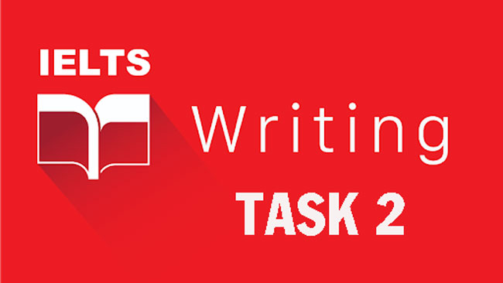

Slide 2
Key Information
# 1 You are required to write 250 words or more.
If you write less than 250 words, you are unlikely to get more than a Band 5 for ’task achievement’ as you won’t have fulfilled the marking criteria.
# 2 You should use a formal style of writing.
# 3 You have around 40 minutes to plan and write your essay.
# 4 Task 2 contributes twice as many marks to your overall score as Task 1.

Slide 3
Step-By-Step Strategy
This 5 step strategy can be used for any question.
1) Analyse the question
2) Plan your answer
3) Write the introduction
4) Write 2 main body paragraphs
5) Write the conclusion

Slide 4
The 5 Question Types
Opinion Essays – Agree or Disagree
Discussion Essays
Problem Solution Essays + Causes & Solutions
Advantages & Disadvantages Essays
Double Question Essays

Slide 5
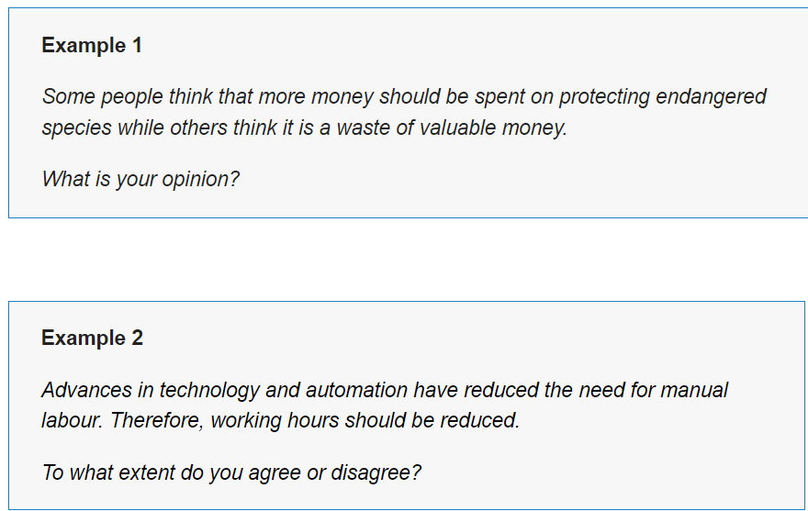
Opinion Essays

Slide 6
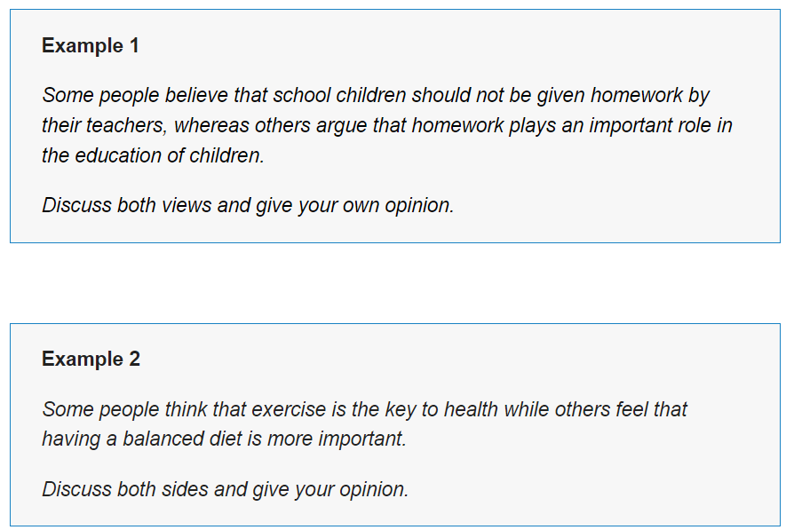
Discussion Essays

Slide 7
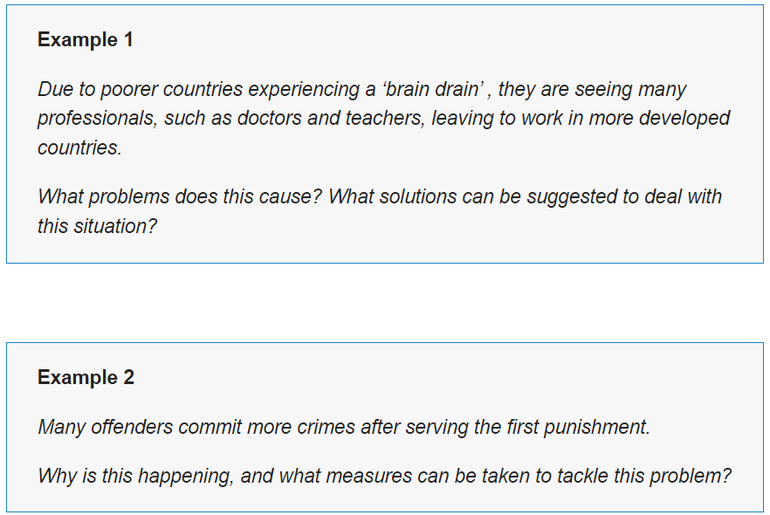
Problem Essays – Causes & Solutions

Slide 8
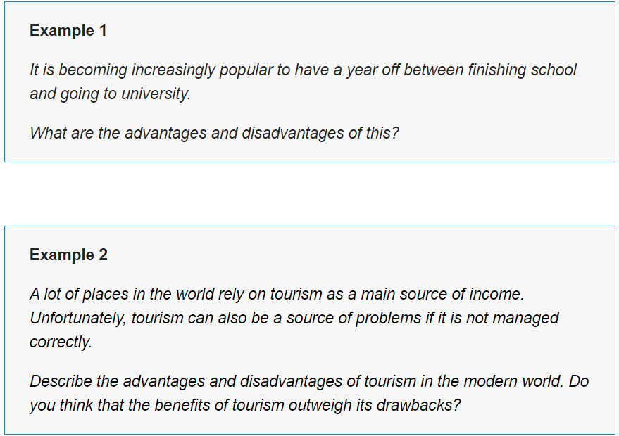
Advantages & Disadvantages Essays

Slide 9
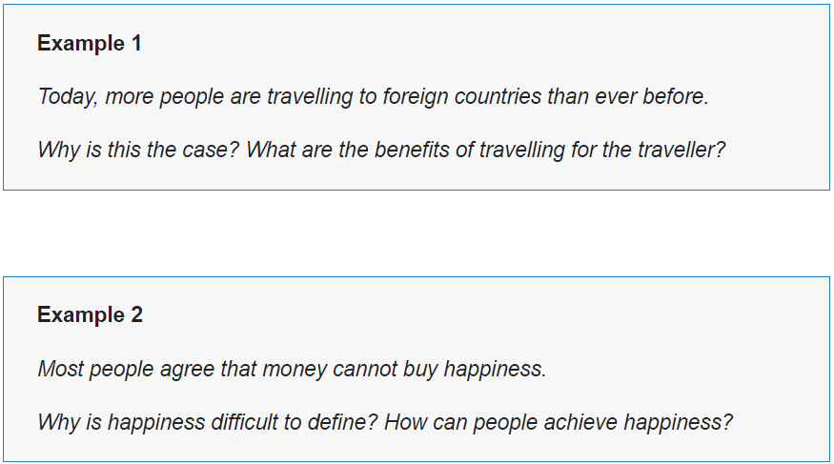
Double Question Essays

